Slide 1
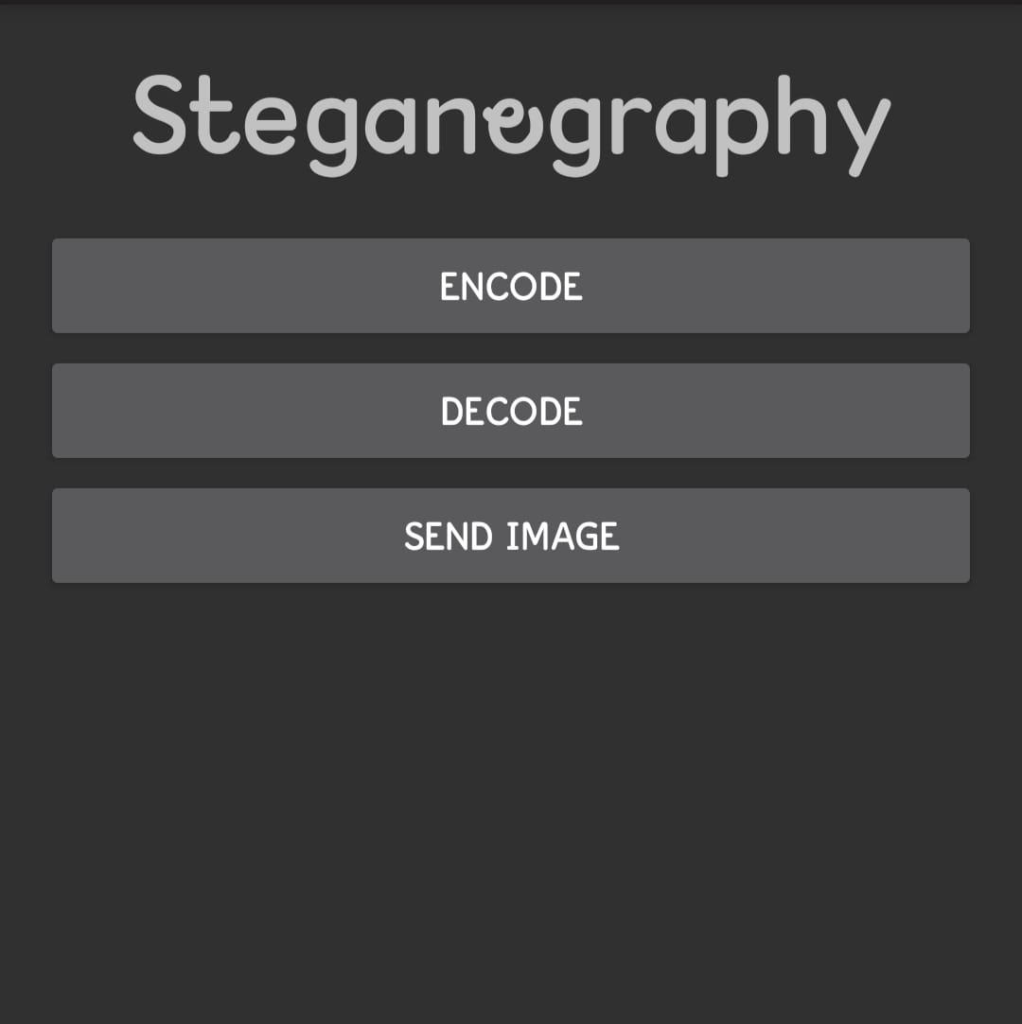

OUTPUT
Home screen
Image

Slide 2
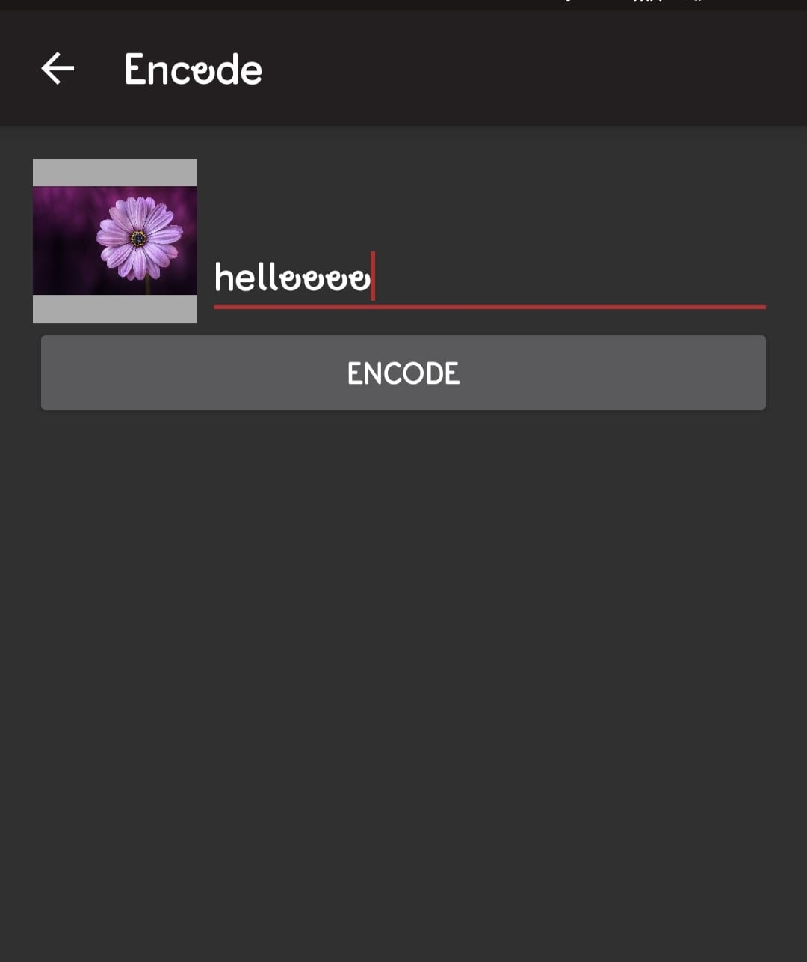
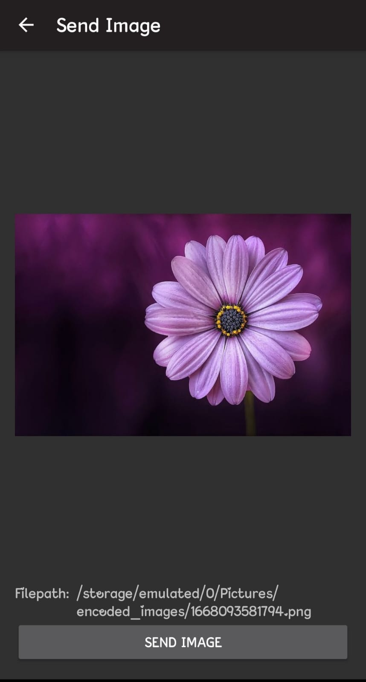
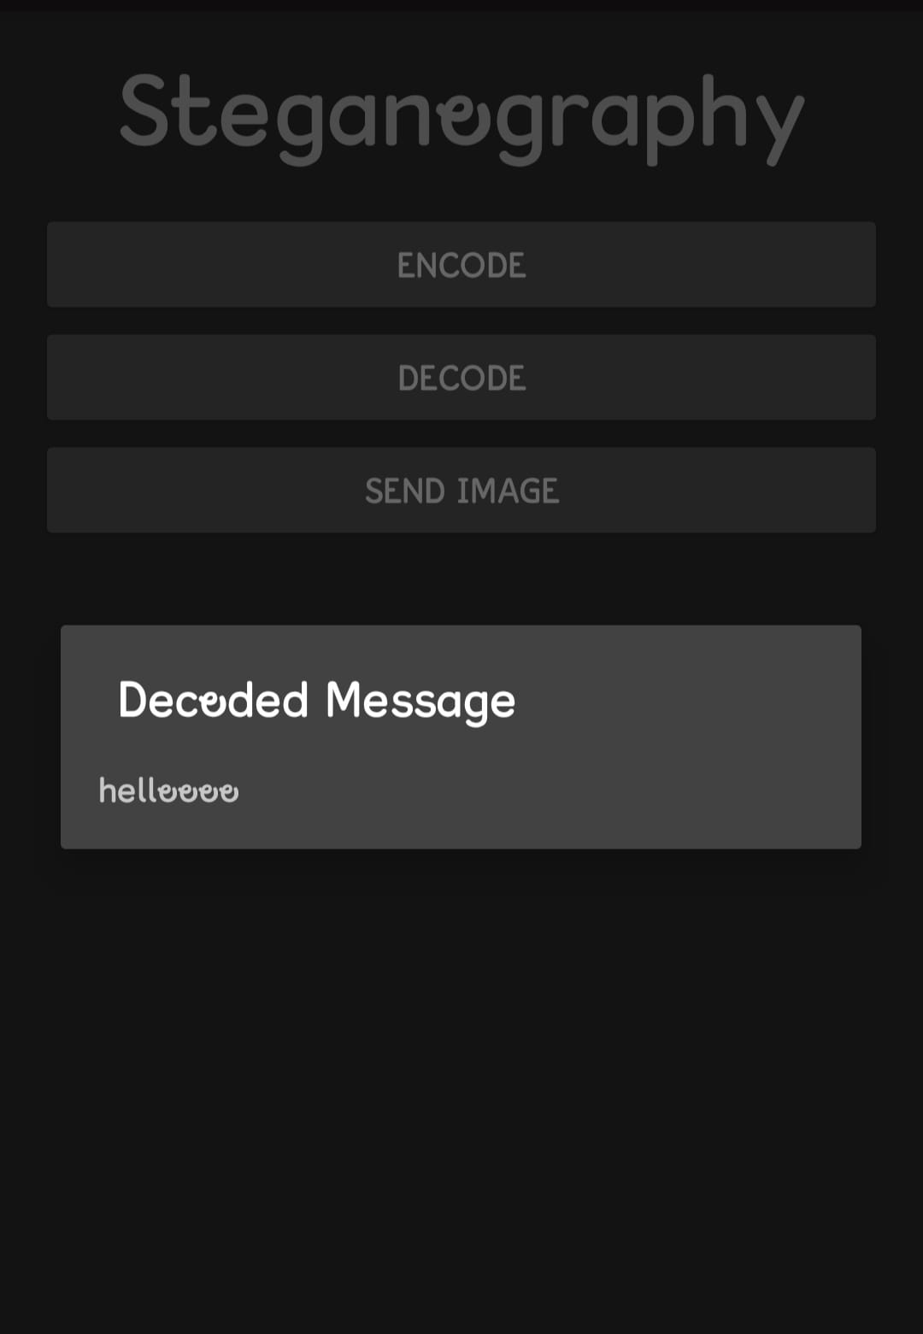
Encrypting the image
Encrypted Image which is in cipher text
Decrypting the image to view the original message

